Slide 1
Management 515
Guerrilla Employees
© 2015, 2016 David E. Frick.
All rights reserved.

Slide 2
What Type of Organization?
Closed and stable
Minimal interaction with customers and environment
Clear boundaries (silos of excellence)
All work is performed within the circle of safety
Clear and intense hierarchy
Open and adaptive
Constant interaction with customers and environment
Permeable boundaries
Work with and influenced by outside actors
Networked governance
Notes:
Organizations and management practices have changed over time in
response to changes in society. New organizations are born when new needs are
discovered as new technologies become available. Organizations die or change when the needs they previously satisfied no longer exist. Writers have provided many
models to characterize organizations. These models become the basis for explanations of organizational events, and they can be broadly classified as closed or open systems. A closed-system tend to focus on internal events while open-system models
focus on external events, which influence changes within the organization. A systems view views an organization as a black box that takes inputs from the environment, process them, and then delivers the outputs back to the environment.
Whether you work in a closed or an open organization is not relevant for this discussion, but it can explain some of the cultural norms that you find in the organization.

Slide 3
What Type of Organization?
Policies
Conflict
Communication
Closed
Open
Notes:
These curves do not have values on the X axis. My point for this graph is to show that, in general, closed organizations have less internal communication and more policies than do open organizations. Oddly, the curve of conflict is lowest at the extreme ends.

Slide 4
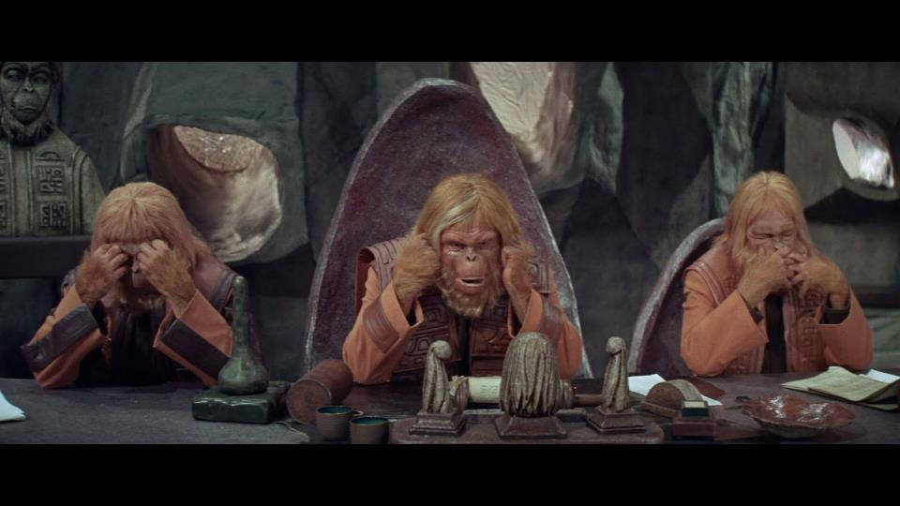
Closed Organizations
Notes:
Closed organizations tend to follow the philosophy of “Hear No Evil” (Non-attribution); “Speak No Evil” (Do not disparage management); and “See No Evil” (Suspend judgment; assume “noble intent” until proven otherwise).
This philosophy may be useful for defending the individuals in the organization, but is not likely to be healthy for the organization.

Slide 5
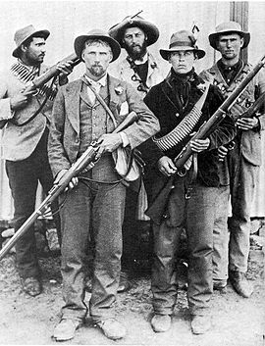
Open Organizations
Afrikaner guerrillas
Boer War, 1899-1902
Guerrilla: “A person who engages in irregular warfare especially as a member of an independent unit carrying out harassment & sabotage.”
Merriam Webster Dictionary
Notes:
Open organizations, on the other hand, leave themselves open to guerrilla actions. Guerrilla action is a tactic not a judgment. All Nations have employed guerrilla tactics during armed conflicts.
Guerrilla means small war in Spanish. It involves the use of a small, mobile force against a large, less mobile one. The guerrilla force is largely or entirely organized in small units that are dependent on the support of the local population. Tactically, the guerrilla army makes massive, repetitive attacks far from the opponent's center of gravity with a view to keeping its own casualties to a minimum and imposing a constant debilitating strain on the enemy. This may provoke the enemy into a brutal, excessively destructive response which will both anger their own supporters and increase support for the guerrillas, ultimately compelling the enemy to withdraw.
For this briefing we are using the term guerrilla employee to mean those employees who “cause disruption.” This may mean open troublemakers, but more often, guerrilla employees disrupt in secret…they are passive aggressive.
Passive aggressive: adj. of or denoting a type of behavior or personality characterized by indirect resistance to the demands of others and an avoidance of direct confrontation, as in procrastinating, pouting, or misplacing important materials. (Oxford Dictionary)

Slide 6
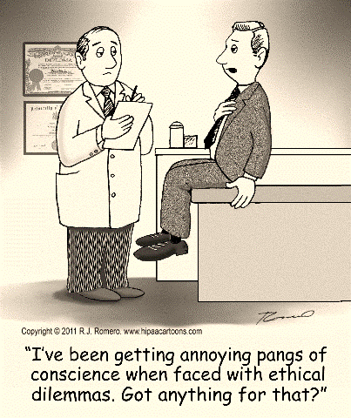
Ethical Issues Create Guerrillas
What constitutes ethical behavior?
Who decides what is ethical?
Which ethical obligations are preeminent?
“Relativity applies to physics, not ethics.
--Albert Einstein
Notes:
Q: Is Einstein right? Are ethics unchanging?
We have already discussed ethics in the business setting. Please reflect on that briefing for a moment.
--What is the basis of ethics in an organization?
--What is the relationship between ethical conduct and rules, regulations, and laws?
--Are guerrilla employees a cause of ethical challenges or a symptom?

Slide 7
Basis of Ethical Thinking
Laws
Self
Nation
Formal Societal Norms
Business Goals
General Welfare
Ethical Question
Professional Norms
Humanity
Family
Religion
Friends
Cultural Norms
Notes:
Identify one principle, rule, or law from each of these domains:
Laws:
Nation:
Business Goals:
Professional Norms:
Family:
Friends:
Cultural Norms:
Religion:
Humanity:
General Welfare:
Formal Societal Norms:
Self:

Slide 8
What Motivates the Guerrilla?
Personal ethics violated—touches deeply held values
Limited or no opportunities for dissent
Perceived cost of voicing opposition greater than cost of guerrilla activity
Quitting would have a destructive effect on the issue
“Guerrilla activity typically happens when there is a lack of trust, fear of retaliation and when employees are rebuffed by superiors.” (O’Leary, 2006)

Slide 9
Guerrilla Options
Loyalty. Wait for conditions to improve
Voice. Express dissent
Exit. Quit
Act. Shirk, sabotage, or strike
“Americans are descended in blood and in spirit from revolutionists and rebels. As their heirs, may we never confuse honest dissent with disloyal subversion.”
Dwight D. Eisenhower
Notes:
Eisenhower would argue that U.S. citizens are natural rebels. They do not stand by and suffer in silence.
--Do you concur?
--Are U.S. citizens more likely to be guerrilla employees?
--Are some cultures more likely to encourage guerrilla action than others?

Slide 10

Guerrilla Tactics
Obey in public, yet disobey in private
Neglect policies and directives. Stall or sabotage
Fail to correct superior's mistakes
Withhold information from superiors
Leak information to the media
Enlist coworkers to plot a unified opposition strategy
Openly disparage the organization, its policies, programs, and management

Slide 11
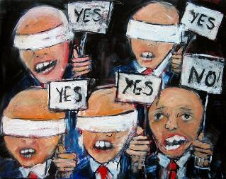
Dissent Has Its Potential Benefits
Presents multiple perspectives
Challenges assumptions
Prompts positive change
Promotes critical, creative thinking
Produces innovation
Kills groupthink
Notes:
Dissent can have value. Remember the chart of conflict (next slide). Some level of conflict is necessary for a healthy organization. Dissent helps to avoid groupthink.
Groupthink. n.
1. the practice of approaching problems or issues as matters that are best dealt with by consensus of a group rather than by individuals acting independently; conformity.
2. the lack of individual creativity, or of a sense of personal responsibility, that is sometimes characteristic of group interaction. (Dictionary.com)

Slide 12
Conflict in an Organization
High
Excessive conflict:
--inhibits communication
--reduces individual performance
--reduces organizational trust
Conflict
Optimal Level of Conflict
Insufficient conflict:
--reduces innovation
--perpetuates inefficient processes
--leads to groupthink
Low
Low
High
Organizational Effectiveness
Notes:
What is the ideal level of conflict? I cannot tell you. What I am confident of is that the extremes, no conflict or all conflict is unhealthy for the organization.

Slide 13
Positive Outcomes
More ethical decisions
More positive workplace
More satisfied employees
Improved performance
Fewer catastrophic outcomes
Notes:
Evidence suggests that groups with a devil's advocate performed much more effectively than the control groups. The presence of a devil’s advocate appears to double the quality of group performance.
B. Waddell, M. Roberto, & S. Yoon, "Uncovering Hidden Profiles: Advocacy in Team Decision Making." Management Decision.
Devil’s advocate: n. a person who advocates an opposing or unpopular cause for the sake of argument or to expose it to a thorough examination (Dictionary.com)

Slide 14
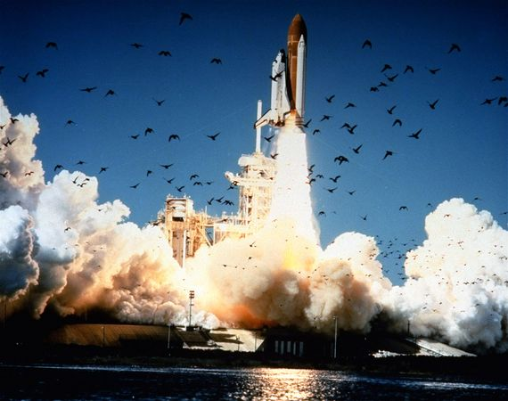
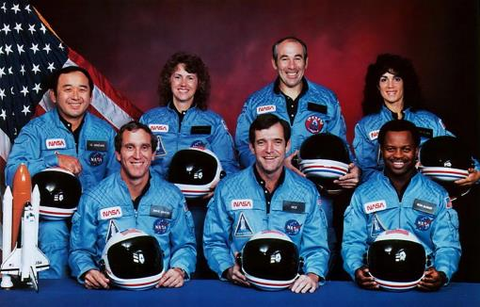
Challenger
Notes:
On January 28, 1986, the space shuttle Challenger exploded in midair, sending six astronauts and schoolteacher Christa McAuliffe to their deaths.
In 1985, Roger M. Boisjoly warned managers that 0-rings used to seal joints in the booster rockets could fail at freezing temperatures. ‘The result would be a catastrophe of the highest order — loss of human life,’ he wrote in a memo. But, the problem had not been resolved when the space shuttle Challenger was prepared for launch on January 28, 1986.
On the night of January 27, temperatures fell below freezing. Boisjoly and four other engineers tried desperately to convince management that the launch should be scrubbed. They warned that the cold would cause rubber o-rings used to seal joints in the rockets to become brittle and fail, allowing hot gases to leak at the joints. Morton Thiokol and NASA managers dismissed the arguments, and decided to go ahead with the launch.
The next day, Challenger lifted off from its pad at Kennedy Space Center. At first, the launch appeared normal, but 73 seconds into flight the shuttle exploded, sending fragments arcing across the bright Florida sky.
President Ronald Reagan established the Rogers Commission to investigate. The Commission cited:
Serious flaw in the decision-making process leading up to the launch of flight 51-L the Challenger flight.
Propensity of management at the Marshall Center to contain potentially serious problems at to attempt to resolve them internally rather than communicate them forward.
The Morton Thiokol management reversed its position and recommended the launch of the Challenger at the urging of the Marshall Center and contrary to the views of its engineers in order to accommodate a major customer. (Wikipedia)

Slide 15
Leadership Remedies
Create a culture that encourages and accepts candid dialog
Cultivate questioning
Promote diversity of thought and intellectual curiosity
Acknowledge dissent and its validity
Understand formal and informal networks
Use formal to get the message out
Use informal to hear the truth
Practice symbolic management
Encourage dissenting “conversations”
Reward courageous acts
Notes:
Culture eats strategy for breakfast. This means that no matter how good your plans, no matter how well meaning your intentions, the culture of the organization will win out with respect to how the group acts.
Even though all of the companies involved in the Challenger disaster “said” that safety was their number one concern, the culture of the organization was “don’t make waves” and “make the customer happy.”

Slide 16
Leadership Remedies
Create channels of dissent
Multiple options for addressing all types of problems
Multiple access points and persons who are easily identified as knowledgeable and trustworthy
Managers are visible, accessible, and available
Create dissent boundaries
Define group norms and procedures that inculcate the acceptance of dissenting opinions
Tuckman’s Model
“Diversity in counsel, unity in command”
--Cyrus The Great
Notes:
My experience as a member of the military.
I served with many good and many bad officers in my career. The bad ones would make a decision without seeking the advice of others. If things went bad (and they often did), the bad officer would normally try to blame others.
The good officers would listen to the advice of other and then make a decision. If things went bad, the officer would admit responsibility.

Slide 17
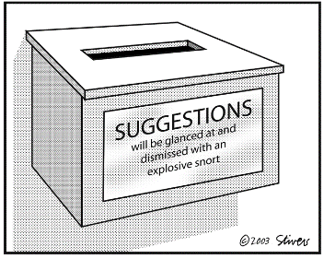
Leadership Remedies
Exercise active listening
Give employees a voice
Look behind the words at the intent
Separate the people from the problem
Respond with respect and professional courtesy
Do not take dissent personally
Ensure confidentiality and safety
Designate a Chief Challenger

Slide 18
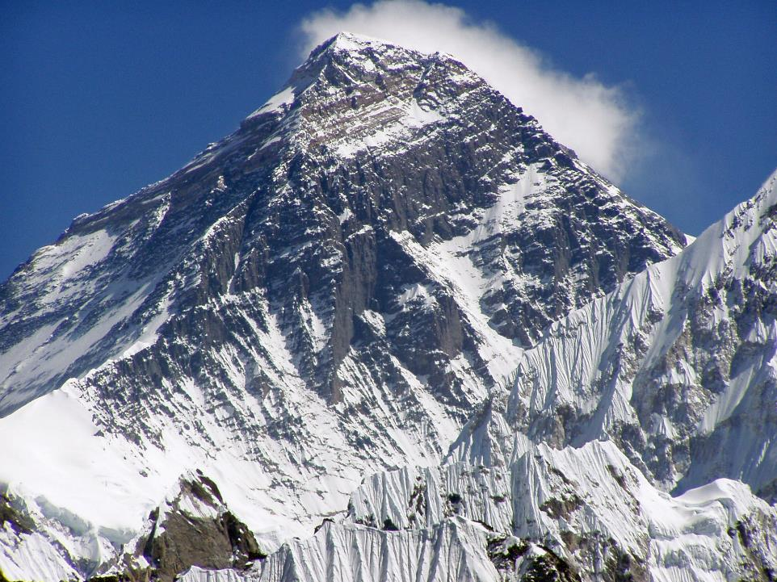
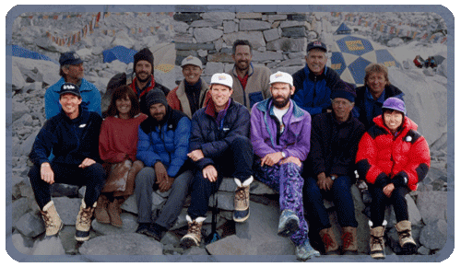
No Dissent on Everest
Notes:
In 1996, Rob Hall and Scott Fischer each led a commercial expedition team attempting to climb Mount Everest. Each group consisted of the leader, several guides, and eight paying clients. Although many team members reached the summit on May 10, they encountered grave dangers during their descent. Five individuals, including the two highly talented leaders, perished as they tried to climb down the mountain during a stormy night.
Unfortunately, the leaders, guides, and most clients ignored the turnaround rule during the ascent. Nearly all the team members, including the two leaders, arrived at the summit after two o’clock. As a result, many climbers found themselves descending in darkness, well past midnight, as a ferocious blizzard enveloped the mountain. Not only did five people die, many others barely escaped with their lives.
Many team members recognized quite explicitly the perils associated with violating the turnaround rule, but they chose not to question the leaders’ judgment. The groups never engaged in an open and candid dialogue regarding the choice to push ahead. Neil Beidleman, a guide on Fischer’s team, had serious reservations about climbing well past midday. However, he did not feel comfortable telling Fischer that the group should turn around. Perceptions of his relative status within the group affected Beidleman’s behavior. He was "quite conscious of his place in the expedition pecking order," and consequently, he chose not to voice his concerns. He reflected back, "I was definitely considered the third guide...so I tried not to be too pushy. As a consequence, I didn’t always speak up when maybe I should have, and now I kick myself for it." Similarly, Jon Krakauer, a journalist climbing as a member of Hall’s team, began to sense the emergence of a "guide-client protocol" that shaped the climbers’ behavior. Krakauer remarked, "On this expedition, he (Andy Harris—one of Rob Hall’s guides) had been cast in the role of invincible guide, there to look after me and the other clients; we had been specifically indoctrinated not to question our guides’ judgment.“
Hall also made it clear to his team during the early days of the expedition that he would not welcome disagreement and debate during the ascent. He believed that others should defer to him because of his vast mountain-climbing expertise and remarkable track record of guiding clients to the summit of Everest. After all, Hall had guided a total of 39 clients to the top during 4 prior expeditions. He offered a stern pronouncement during the early days of the climb: "I will tolerate no dissension up there. My word will be absolute law, beyond appeal." Hall made the statement because he wanted to preempt pushback from clients who might resist turning around if he instructed them to do so. Ironically, Hall fell behind schedule on summit day and should have turned back, but the clients did not challenge his decision to push ahead. Because of Hall’s early declaration of authority, Krakauer concluded that, "Passivity on the part of the clients had thus been encouraged throughout our expedition."
Before long, deference to the "experts" became a routine behavior for the team members. When the experts began to violate their own procedures or make other crucial mistakes, that pattern of deference persisted. Less-experienced team members remained hesitant to raise questions or concerns. Fischer’s situation proved especially tragic. His physical condition deteriorated badly during the final summit push, and his difficulties became apparent to everyone including the relative novices. He struggled to put one foot in front of the other, yet "nobody discussed Fischer’s exhausted appearance" or suggested that he should retreat down the slopes.
Source: Michael Roberto, Why Great Leaders Don’t Take Yes for an Answer, (Chapter 1).

